Slide 1
TDI: Julia
Character & String in Julia
William Mui

Slide 2
Represent a letter in Computer

Slide 3
Encoding
Characters are mapped to a value
It is called encoding
Character examples:
English
Chinese
Special characters (@,%...)
Invisible characters

Slide 4
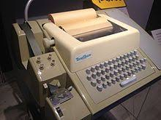
ASCII Table
American Standard Code for Information Interchange(ASCII)
Developed and published in 1963
For Teleprinter -> control characters
Uses 7 bits to encode characters
Photo source: Wikipedia/Teleprinter

Slide 5
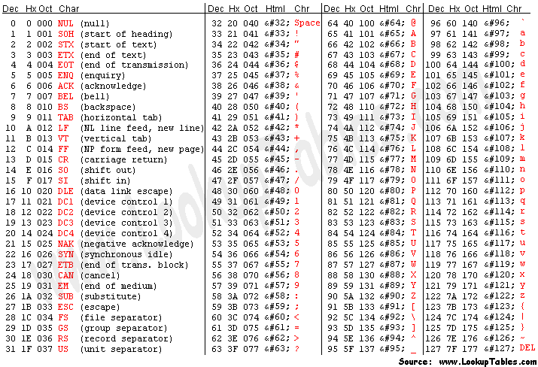
ASCII table

Slide 6
Unicode
Maintained by Unicode Consortium
Different implementation: UTF-8, UTF-16, UTF-32…
The first version: October 1991
Encoded 137,994 characters in May 2019
137,766 graphic characters
163 format characters
65 control characters

Slide 7
Character in Julia

Slide 8
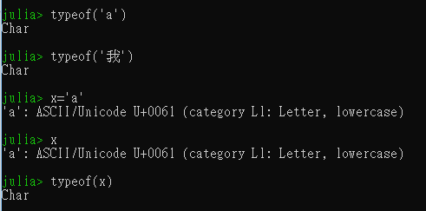
Character in Julia
Using ASCII and UTF-8
1-4 bytes to store a singer character
Stored by type Char

Slide 9
Declare a char variable
Use a single quote to wrap the character
Julia will decide the type

Slide 10
String

Slide 11
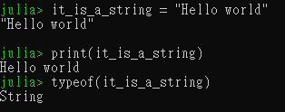
String
Sequence of characters
Wrapped by double quotes or triple double quotes
Example:

Slide 12
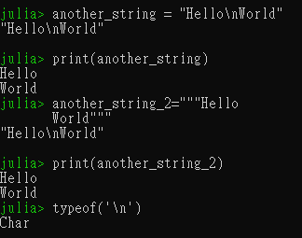
New line character
In String, it is always considered as one line when it prints
If we need to add a new line in printing, use the new line character
New line character: ‘\n’
It is considered as one character

Slide 13
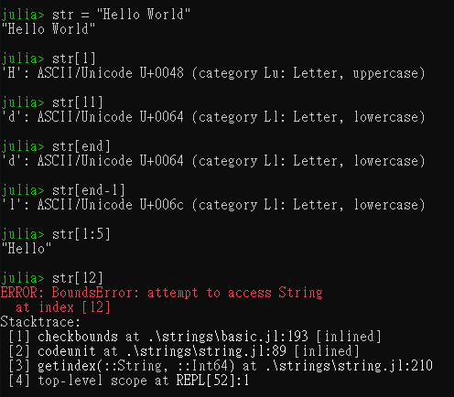
Access the character in string
Access by: (name) [ (position) ]
The position is starting from 1
Use str[end] to access the last character in str
Expression in square brackets is allowed

Slide 14
Access the sub-string
Access by: (name)[(start positon):(end positon)]
In alternative, we may use the function SubString(str, 1, 5)

Slide 15
String Operators

Slide 16
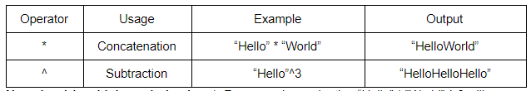
String Operators
The following operators are supported by Julia:

Slide 17

String Operators Priority
The “^” operator has higher priority than “*” operator
For example, evaluating “Hello” * ”World” ^ 3

Slide 18
String Interpolation

Slide 19
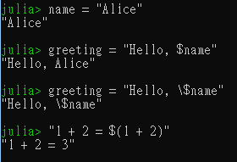
String Interpolation
Create a new string based on the previous defined
Variable
String
expression

